Slide 1
Chapter 500
Steering
Committee
Meeting #4
7/15/24, 9:30am – 1:00pm
Deering Conference Room 101
90 Blossom Lane, Augusta, ME

Slide 2
Agenda
Welcome and recap last Steering Committee meeting (10 mins)
Department updates: Rulemaking timeline, MCGP, MS4GP (10 mins)
Goals of Ch. 500 update and DEP’s proposed framework (20 mins)
Status update from the Technical Committee (15 mins)
5. Steering Committee discussion (60 mins)
6. Stakeholder input (30 mins)
7. Additional Steering Committee discussion (30 mins)
8. Action Items & Next Steps (20 mins)
BREAK (5 mins)
BREAK (10 mins)
2

Slide 3
Last Steering Committee Recap: Feb. 26th, 2024
The meeting minutes available on the stakeholder engagement webpage.
Topics Covered:
  Topics & Considerations Review
  Taunton Watershed Project Recap & Discussion
  Impervious Cover Analysis Recap & Discussion
  LID Standards Discussion
  Flooding Standards Discussion
  Stakeholder Input

Slide 4
Milestone | Initial (First SC Meeting) | Updated (Fourth SC Meeting)
 | Date
Stakeholder Kick-off Meeting | December 2023 | December 2023
Stormwater BMP Manual Update Project* | March 2024 – December 2025 | TBD – 2026*
Final Stakeholder Meeting | June 2024 | November 2024
Draft proposed rules (with stakeholder review/written feedback) | May-July 2024 | December 2024 – mid-2025
Introduce proposed rule to BEP | Mid to Late 2024 | Mid-2025
Provisionally adopted rule filed with Legislature | January 2025 | January 2026
Final Adoption of the Rules by BEP | Mid-2025 | Mid-2026
Final Manual | End of 2025 | Mid-2026
*: No contractor on board yet; first Request for Proposal received no bid. Starting date “To Be Determined (TBD)”

Slide 5
MCGP
  Draft MCGP published for public comment (March 20th- May 20th)
  The draft MCGP has a new appendix (Appendix D) that includes
    Standards for the “large construction activities” disturbing five or more acres
  BLR is currently reviewing the written comments & revising the draft MCGP
  New MCGP will be issued by Fall 2024

Slide 6
Municipal MS4GP Modification
On June 21st, 2024
  Informal 30-day comment period started on the modified Appendix F draft. The comment period ends on 7/22/24:
    Appendix F includes performance standards for 11 LID Measures
    BWQ and BLR collaborated to develop the Appendix F draft
On June 26th, 2024
  LID ordinance adoption deadline for the 30 municipal permittees has been revised:
    Original deadline: 7/1/2024
    New deadline: 11/5/2025

Slide 7
Goals of Ch. 500 update and
DEP’s proposed framework
(20 minutes)

Slide 8
Overarching Goals
Promote Low Impact Development (LID)
Address Climate Adaptation & Resiliency
Streamline Rules (Improve Day-to-day Implementation)

Slide 9
Requirements under LID Proposal
Enhanced Requirements:
  Projects in UIS watersheds
  Projects in Sensitive/Threatened watersheds
  Projects that develop >10% of a watershed
Core Requirements:
  Any projects not in the above
Replacing current BMP requirements with LID Standard

Slide 10
Proposed Decision Tree
Is the project in a lake watershed?
No
Yes
select one of the options below
G Meet the LID and Stormwater Quality Requirements for Sensitive and Threatened Watersheds
Use Phosphorus stressor
H Meet the Phosphorus Standard
Project in Urban Impaired Stream (UIS) Watershed
Meet the following requirements:
Project in Sensitive or Threatened Watershed
Meet the following requirements:
Project not in a UIS or Sensitive and Threatened watershed
Meet the following requirements:
A Full LID Recharge Requirement
D Watershed stressor guided SCM/BMP selection to meet stormwater performance curve requirements
F Flood Control
Apply watershed specific model if available
B Reduced LID Recharge Requirement (75%)
E Watershed stressor guided SCM/BMP selection to meet reduced stormwater performance curve requirements
C Core LID only if Developed Area is <10% of the receiving watershed at the point of discharge
If >10% meet requirements for sensitive and threatened watersheds

Slide 11
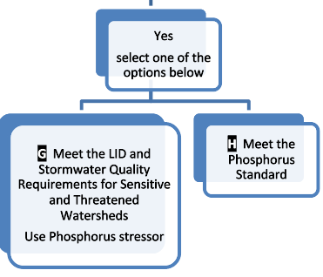
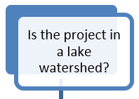
Decision Tree - Step 1: Yes
Same as current requirements
New Sensitive and Threatened requirements

Slide 12
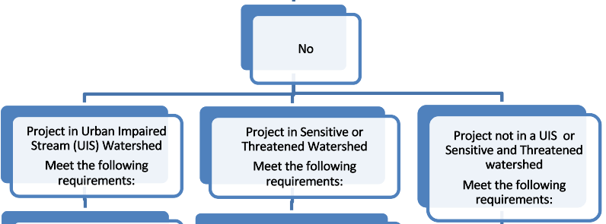
Decision Tree - Step 1: No
Three different paths, depending on project watershed and size

Slide 13
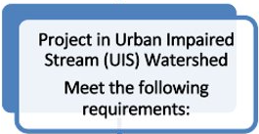
Decision Tree - Step 2: UIS
Groundwater Recharge
Stressor Guided BMP Selection
Flood control

Slide 14
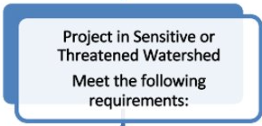
Decision Tree - Step 2: Sensitive and Threatened
Groundwater Recharge
Stressor Guided BMP Selection

Slide 15
Decision Tree - Step 2: Not UIS or S/T
Project <10% of watershed size: Core LID only
Project >10% of watershed size: Sensitive and Threatened Watershed requirements

Slide 16
Current Chapter 500 & MCGP
Thresholds identical → disturb ≥ 1 acre
Chapter 500 includes Erosion and Sedimentation Control in Basic Standards
  Redundant with MCGP
Submit NOI for MCGP within application for Stormwater Law (Chapter 500)
  Construction details may be unknown at time of application

Slide 17
New Chapter 500 & MCGP
Proposal: Remove Basic Standards from Chapter 500
  Chapter 500 covers only post-construction stormwater management
MCGP covers Basic Standards
  MCGP covers construction stormwater management
Submit NOI for MCGP when ready for construction to begin → get better plans

Slide 18
New Chapter 500 & MS4GP
MS4GP out of scope of Chapter 500 updates
Can Chapter 500 update help with MS4GP?
  Use new Chapter 500 as a technical reference → comply with Minimum Control Measure 5: Post-Construction Stormwater Management in New Development and Redevelopment
Intent for MS4GP LID to not conflict with Chapter 500
Acknowledge timelines don’t align
  MS4 permittees may adjust LID ordinances using new Chapter 500

Slide 19
Status Update from the Technical Committee
(15 minutes)

Slide 20
Tasks Assigned to the Technical Committee

Slide 21
A. Low Impact Development (LID)
    Clarify in the language that the goal is specifically to minimize impacts.
    ii. Decipher between threatened and sensitive watersheds.
    iii. Define low maintenance vegetation and consider – low maintenance to who?
    iv. Specify requirements based on different applications*.
    v. Develop a framework for testing the rule changes under different scenarios**.
*: Development vs redevelopment; stream class; sensitive vs. threatened; pollutants of concern; rural vs. urban; population type/resource access
**: Project description → size, new development vs. redevelopment; project description/impact characteristics; cost
21

Slide 22
B. Flooding
    Decide on which source to use for precipitation data.
    ii. Determine the uncertainty that persists after changes are made and decide how this will be dealt with.
      This goes along with testing the standard after changes are made by running it through scenarios, similar to LID standard.
    iii. Define DEP scope and consider how this can be framed around a watershed-wide perspective as opposed to project site specific view. Consider how regulations from other agencies and municipalities impact this.
    iv. Specify flood requirements based on stream risk/classifications (similar to LID TC task)
22

Slide 23
C. Other
    Clarify language to ensure standards can be understood by less technical audiences.
    Ensure proper education of changes made (this is a task related to all Ch500 changes made, not just flooding standard).
    iii. How to incorporate Environmental Justice?
23

Slide 24
Summary of the Technical Committee Activities
Meetings:
  Technical Committee: March 18th, April 1st, June 25th
  Sub-committees:
    Core LID: March 25th, April 12th
    Groundwater Recharge: March 26th, April 5th
    Definitions: March 29th, April 5th, April 26th
Emerging Consensus Points

Slide 25
Break
5 min

Slide 26
Steering Committee discussion
(60 minutes)

Slide 27
Discussion questions
Do you agree with the overall goals for the Ch. 500 update?
What is your feedback on the DEP’s proposed framework for updating Ch. 500?
  What aspects are you most excited about?
  What important elements are missing?
  Do you have any concerns?
  Do you have any suggested changes or alternative proposals?

Slide 28
Break
10 min

Slide 29
Stakeholder input
(30 minutes)

Slide 30
Discussion questions
Do you agree with the overall goals for the Ch. 500 update?
What is your feedback on the DEP’s proposed framework for updating Ch. 500?
  What aspects are you most excited about?
  What important elements are missing?
  Do you have any concerns?
  Do you have any suggested changes or alternative proposals?

Slide 31
Additional Steering Committee discussion
(30 minutes)

Slide 32
Action Items & Next Steps
(20 min)
Tasks Assigned to the Technical Committee
  Amendments, Add New Tasks, Remove Tasks
Tentative Date & Agenda for the Next Steering Committee Meeting
Additional Information Requested from the Department
Others

Slide 33

chapter500.dep@maine.gov www.

Slide 34
Additional Discussion Topics
(Contingent on Time Availability)

Slide 35
Environmental Justice
How does Environmental Justice (EJ) apply in the context of stormwater management?
Are special EJ provisions necessary for
  Certain areas
  Certain projects (e.g., affordable housing)

Slide 36
Sensitive and Threatened Stream Discussion
Steering Committee mtg #4
Jeff Dennis
Watershed Management Unit

Slide 37
Stormwater Management Law §420-D.4
Degraded, sensitive or threatened regions or watersheds.
The department shall establish by rule a list of degraded, sensitive or threatened regions or watersheds” including those which “Have been degraded or are susceptible to degradation of water quality or fisheries because of the cumulative effect of past or reasonably foreseeable levels of development activity within the watershed of the affected surface waters; and are not classified as most at risk”.

Slide 38
The intention of this effort to define Sensitive and Threatened Regions and Watersheds is not to create a new stormwater management standard that is more burdensome than the current one size fits all General Standard, but rather to:
Identify watersheds that are most vulnerable to impairment of their aquatic life and require stormwater management practices targeted to efficiently address the particular vulnerabilities of each receiving water
To avoid requiring unnecessary, sophisticated stormwater management in the large majority of the State
Independent of state regulation, to inform and guide local efforts to protect these watersheds
38

Slide 39
Identification of S&T stream watersheds - Challenges
What metric(s) should be used?

Slide 40
Effects of Urbanization on the Aquatic Life of Maine Streams
Danielson, TJ et al. 2016 MDEP
Evaluated 140 catchments upstream of biomonitoring sample locations
Concluded that streams become vulnerable to no longer attaining Aquatic Life Criteria when % Impervious Cover exceeds:
  Class AA/A – 1% to 3%
  Class B – 3% to 6%
  Class C – 10% to 15%

Slide 41
Identification of S&T stream watersheds - Challenges
What metric(s) should be used?
  Current % impervious cover (IC) in the watershed
  Recent change in %IC over time
What % IC thresholds should be used for inclusion on the list?
  > 10% current IC
  7 to 10 % current IC, change in % IC 2001 – 2019 > 1%
  4 to 7 % current IC, change in % IC 2001 – 2019 > 2%
What streams should be evaluated?
  Stream order – 1st, 2nd and some 3rd
What should the watershed size threshold be?
  Reasonable size threshold will exclude many small, viable streams
  Tested > 200 and > 250 acres

Slide 42
Identification of S&T stream watersheds - Challenges
Urban and rapidly urbanizing watershed conundrum
The proposed decision tree would only require Core LID in watersheds that are not on the S&T List, the UIS List or in a lake watershed
A Catchment Size threshold of 0.8 sq km or higher will leave many viable streams off the S&T list
In already urban or rapidly urbanizing areas this will result in many currently high IC small streams with inadequate protection
Possible solution – Identify urban/urbanizing “regions” that would protect these streams
All regulated development would have to meet the S&T stormwater requirements
“Regions” could be highly impervious and high growth municipalities
Would dramatically reduce the number of individual S&T watersheds making implementation much easier

Slide 43
Identification of S&T stream watersheds - Challenges
Data sources were not perfect
NLCD IC vs C-CAP 2021 IC
NHD high resolution layer often delineated stream catchments that were mostly tidal or included direct drainage to major rivers or coastal waters
NLCD IC identified identified solar arrays as impervious
C-CAP 2021 IC identified gravel pits as impervious
As a result, confirmation of the validity of each catchment’s info using contours and a variety of aerial photo sources was required. More than 70 catchments were discarded.

Slide 44
Results of Initial Effort
Tested a hybrid formula for identifying potential sensitive and threatened regions ( Combination of current IC, IC change and the number of high IC catchments in the municipality)
Auburn | Eastport | Lewiston | Waterville
Augusta | Eliot | Oakland | Wells
Bangor | Falmouth | Old Orchard Beach | Westbrook
Bath | Fairfield | Portland | Windham
Belfast | Freeport | Saco | Winslow
Biddeford | Gardiner | Sanford | Yarmouth
Brewer | Gorham | Scarborough | York
Brunswick | Hallowell | Skowhegan
Cape Elizabeth | Kennebunk | South Portland
Cumberland | Kittery | Topsham

Slide 45
Results of Initial Effort
Identified 231 1st and 2nd order stream catchments >200 acres that exceeded the current % IC and the change in % IC thresholds. Of these:
  171 were within the S & T Region municipalities, including 33 that were in an Urban Impaired Stream watershed
  50 were not within the S & T Region municipalities, including 2 that were in an urban impaired stream watershed
  48 stream watersheds would be listed separately as Sensitive and Threatened Watersheds in Chapter 502
  37 municipalities would be listed as Sensitive and Threatened Regions in Chapter 502

Slide 46
jeff.dennis@maine.gov

